Slide 1
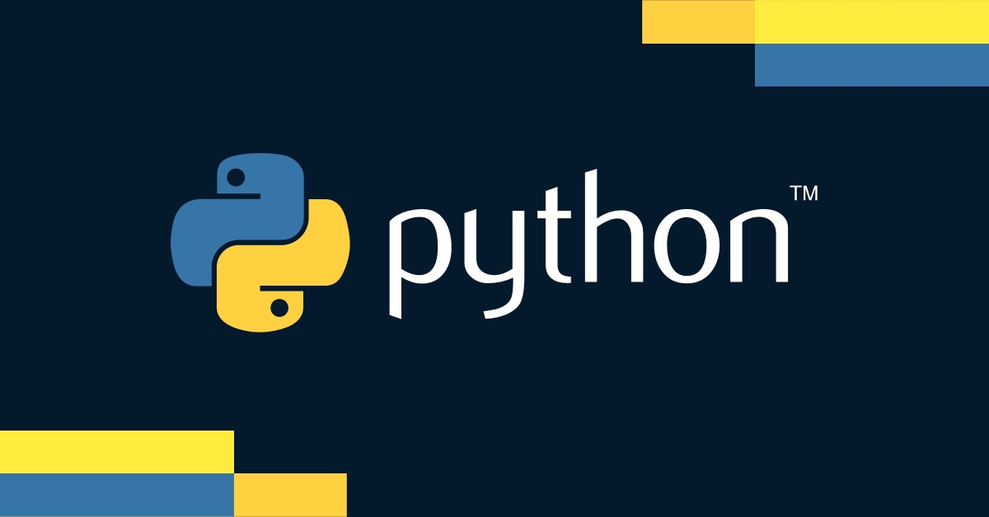

Slide 2
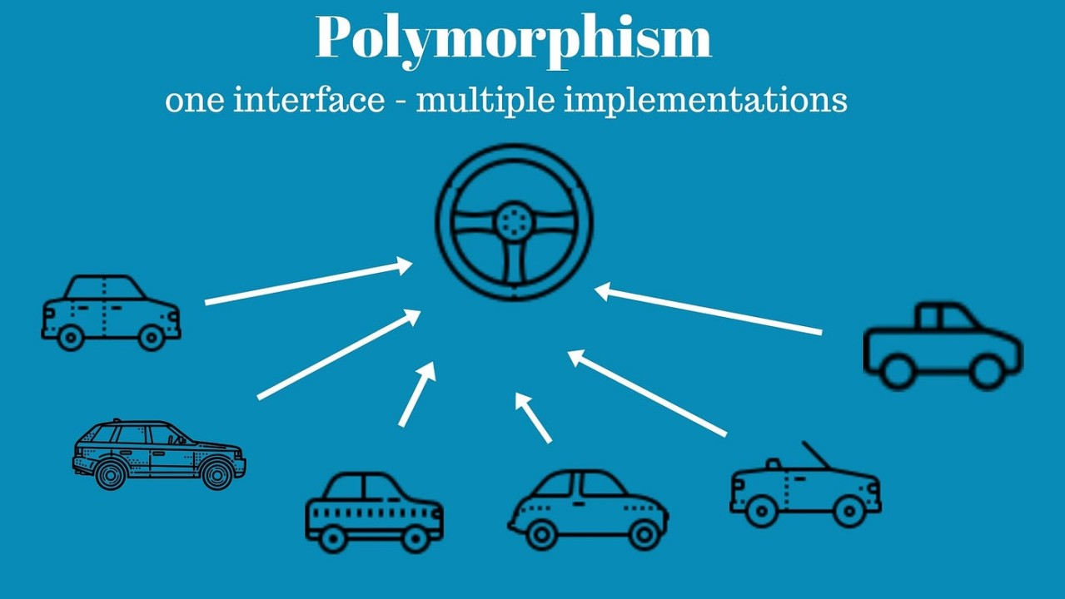

Slide 3
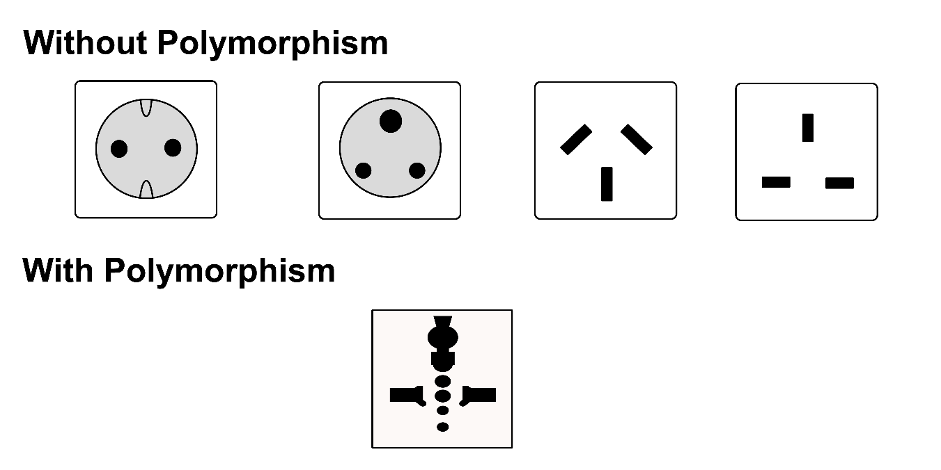
Introduction to Polymorphism
Definition
Polymorphism is the ability of different classes to be treated as instances of the same class through a common interface. It allows methods to do different things based on the object it is acting upon
Purpose
Promotes flexibility and integration
in code design

Slide 4

Key Concepts of Polymorphism
Polymorphic Behavior
The ability of different objects to respond to the same method in different ways
Common Interface
Methods with the same name that can work on objects of different classes

Slide 5

Benefits of Polymorphism
Flexibility
Write flexible and reusable code
Maintainability
Easier to extend and maintain
Integration
Allows objects of different types to be integrated smoothly

Slide 6
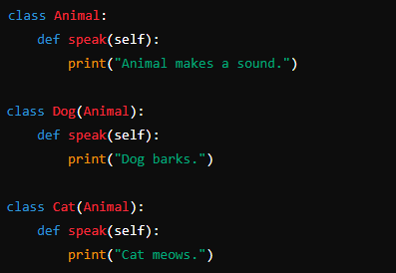
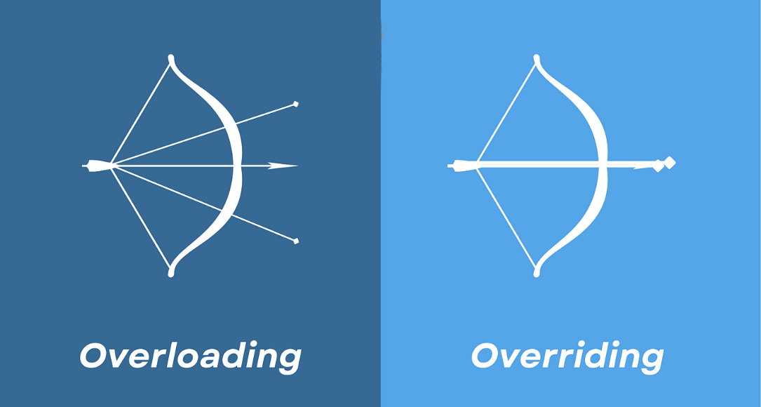
Method Overriding
Definition
Method overriding allows a child class to provide a specific implementation of a method already defined in its parent class
Example
In Python, method overloading isn't supported in the traditional sense

Slide 7
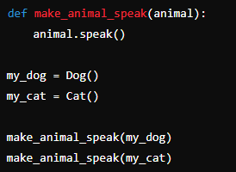
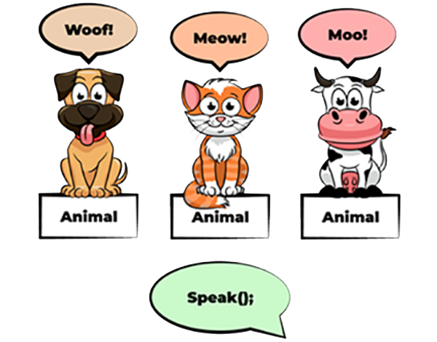
Demonstrating Polymorphism

Slide 8


Polymorphism with Inheritance
By inheriting from the Animal class, Bird can override the speak method, providing its own implementation

Slide 9
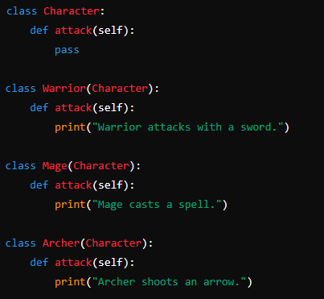
Practical Use Case
Scenario
Suppose you are designing a game with different types of characters :
Warrior
Mage
Archer
Each character has a method attack()

Slide 10
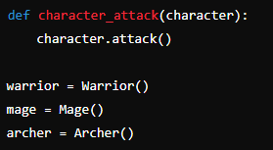

Polymorphism in the Game
Example
Explanation
This example demonstrates how polymorphism allows the character_attack function to call the appropriate attack method for each character type

Slide 11
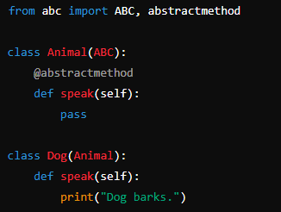
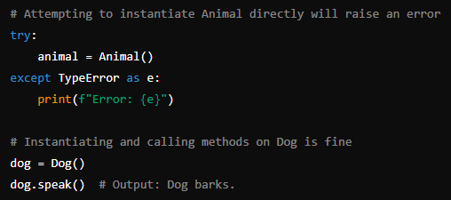
Polymorphism with Abstract Base Classes
Definition
Abstract base classes provide a way to define a common interface for a group of related classes
Example

Slide 12

What is polymorphism in Python?
Allowing methods to do different things based on the object they are acting upon
How is method overriding related to polymorphism?
Allows subclass to provide a specific implementation of a method already defined in its superclass
How does polymorphism enhance code flexibility?
Allows different classes to be treated uniformly, promoting code flexibility by common interface for interacting with various object types
What are abstract base classes (ABCs) in Python, and how do they relate to polymorphism?
Define a common interface for a group of related classes
Can method overloading be achieved in Python?
No, Python does not support method overloading in the traditional sense as seen in languages like Java or C++

Slide 13

Create a base class Shape with an abstract method area(). Then create subclasses Circle and Square that implement the area method

